Slide 1
Coupledline Compiled Data

Slide 2
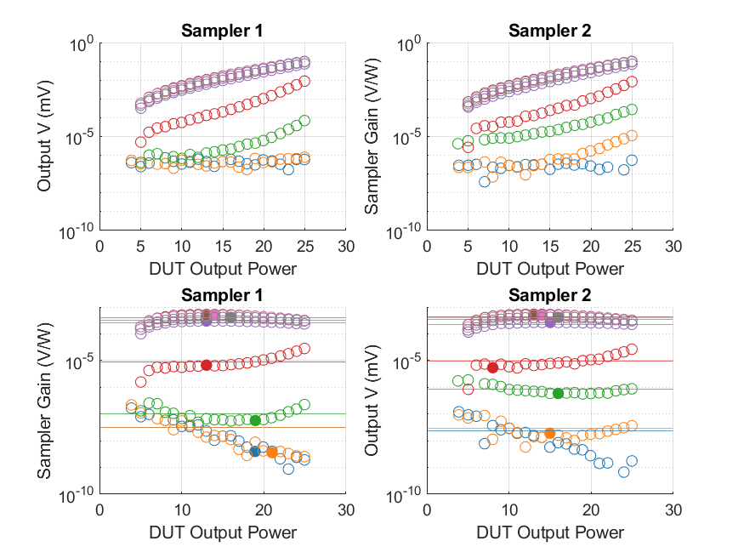
Coupled Line Performance At 8.00 GHz

Slide 3
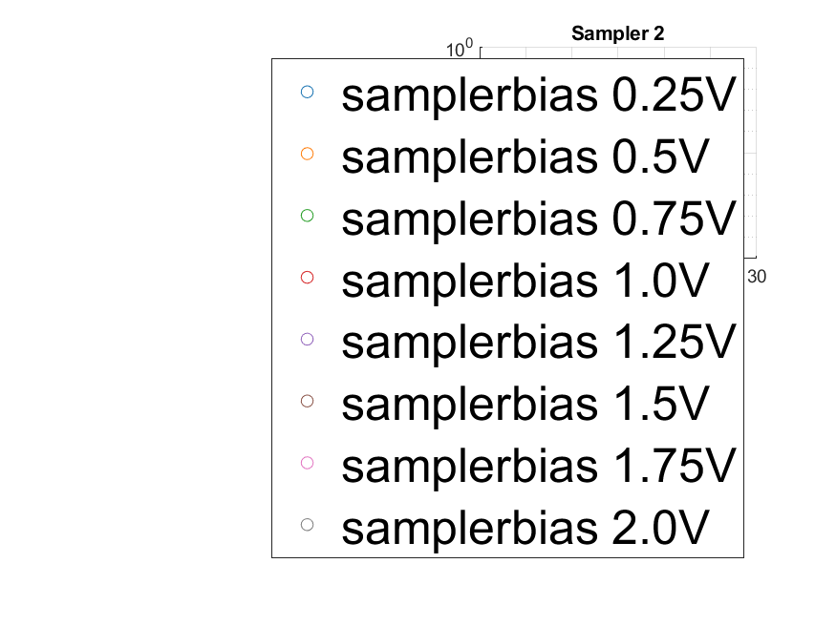
Coupled Line Bias Legend

Slide 4
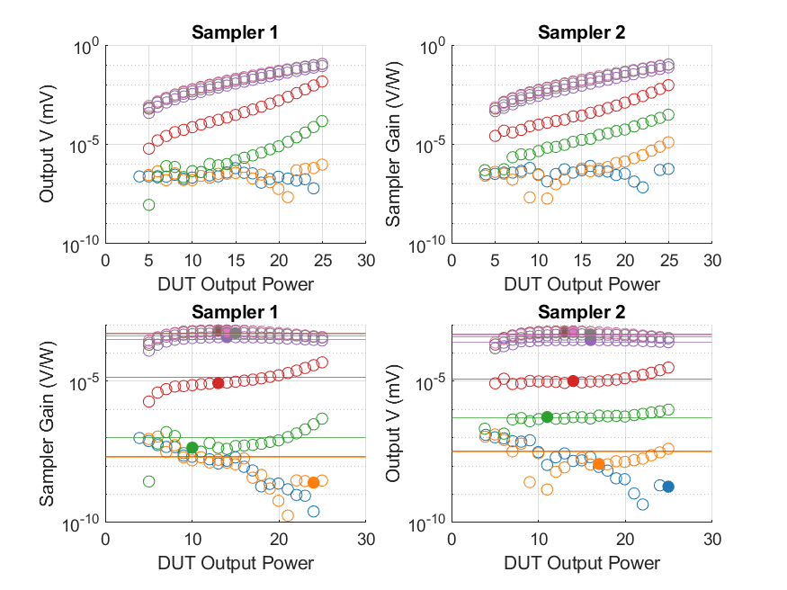
Coupled Line Performance At 8.10 GHz

Slide 5
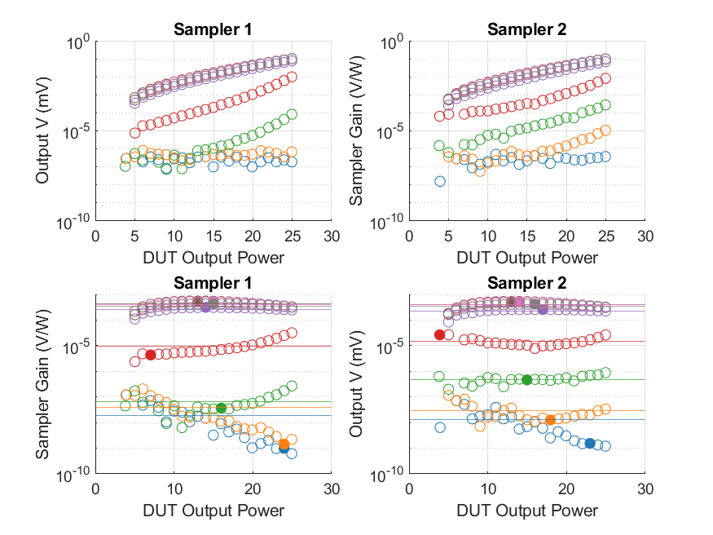
Coupled Line Performance At 8.20 GHz

Slide 6
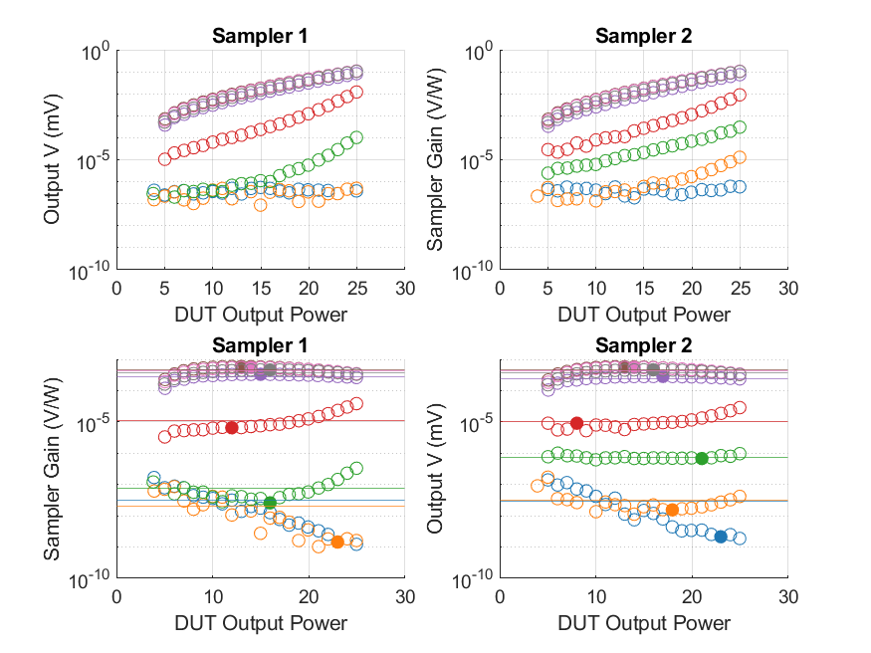
Coupled Line Performance At 8.30 GHz

Slide 7
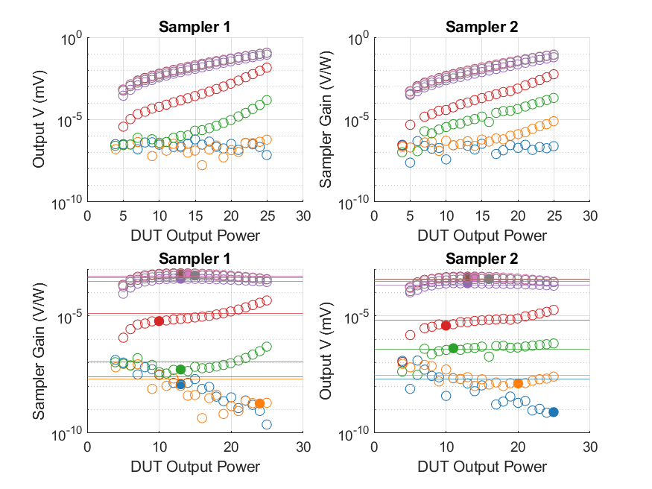
Coupled Line Performance At 8.40 GHz

Slide 8
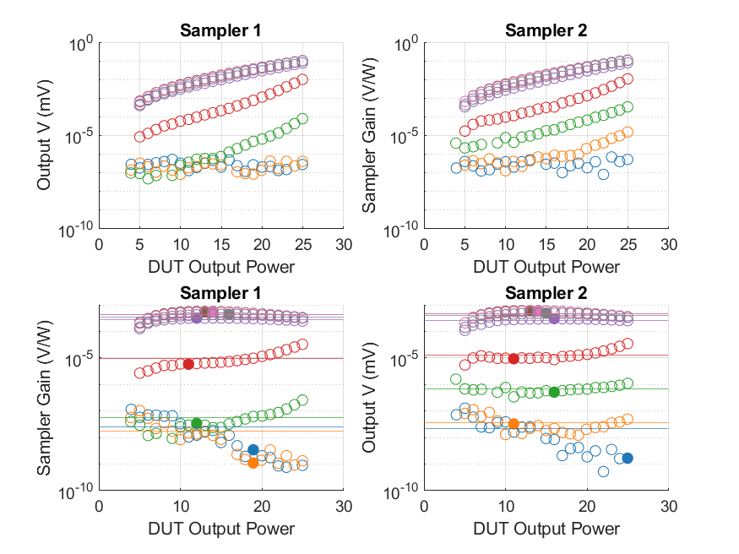
Coupled Line Performance At 8.50 GHz

Slide 9
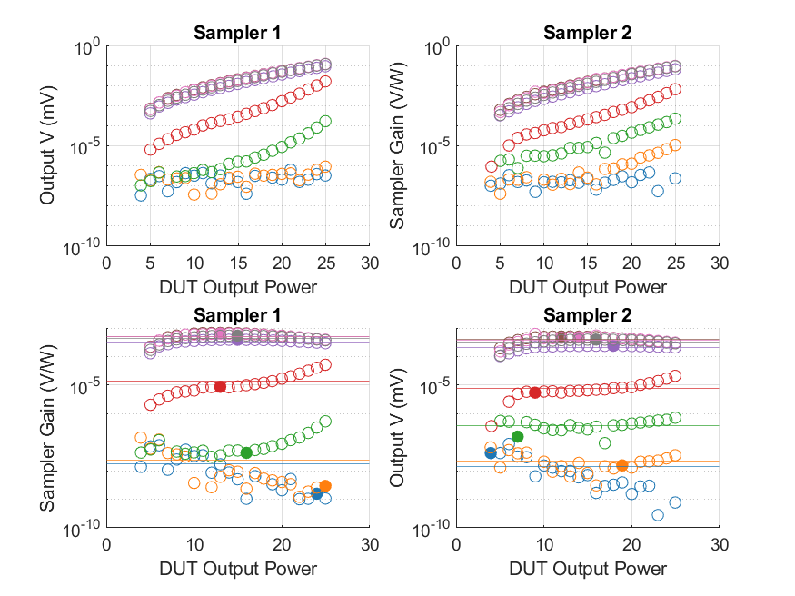
Coupled Line Performance At 8.60 GHz

Slide 10
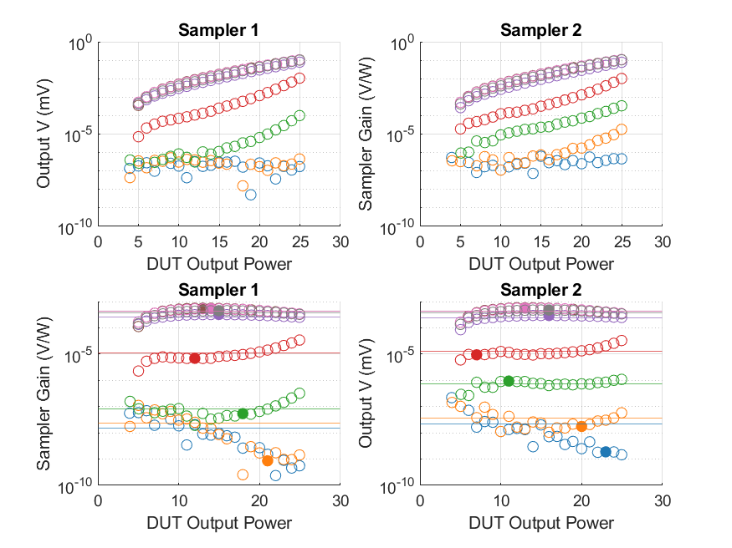
Coupled Line Performance At 8.70 GHz

Slide 11
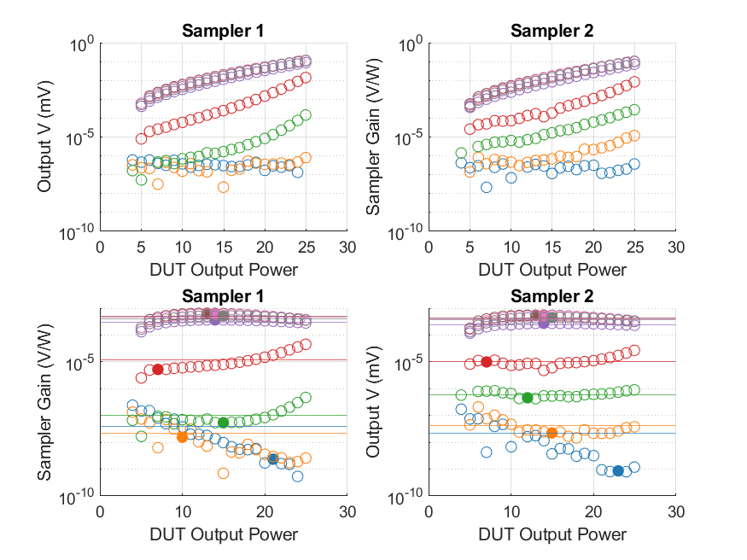
Coupled Line Performance At 8.80 GHz

Slide 12
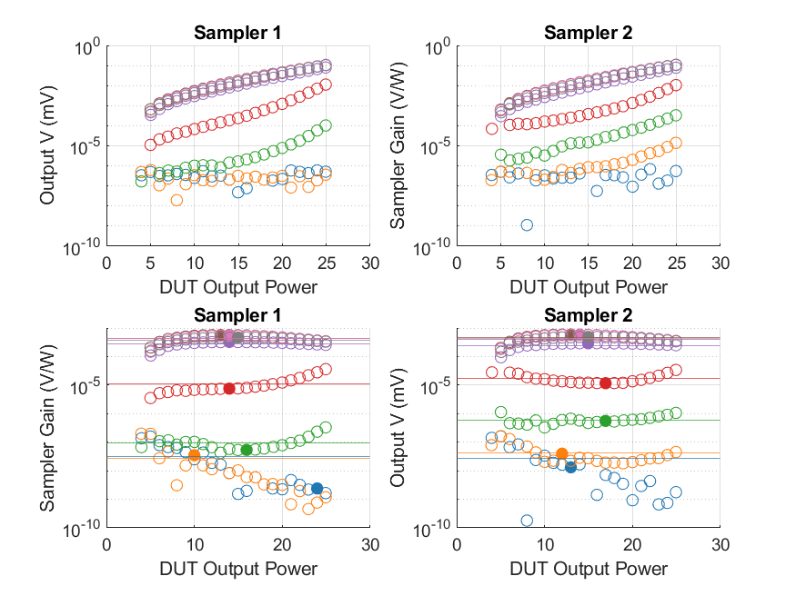
Coupled Line Performance At 8.90 GHz

Slide 13
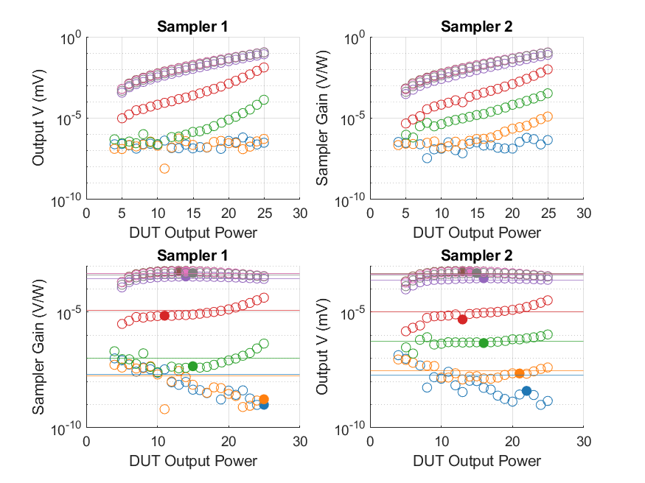
Coupled Line Performance At 9.00 GHz

Slide 14
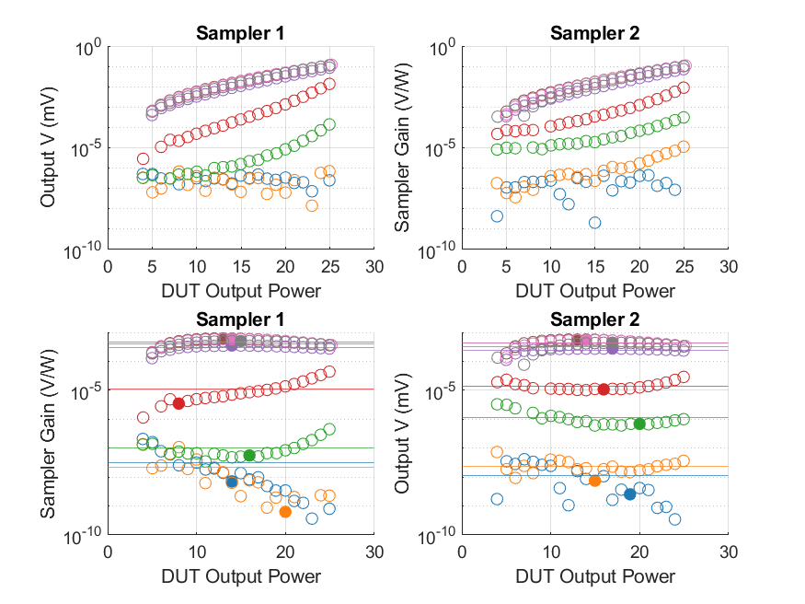
Coupled Line Performance At 9.10 GHz

Slide 15
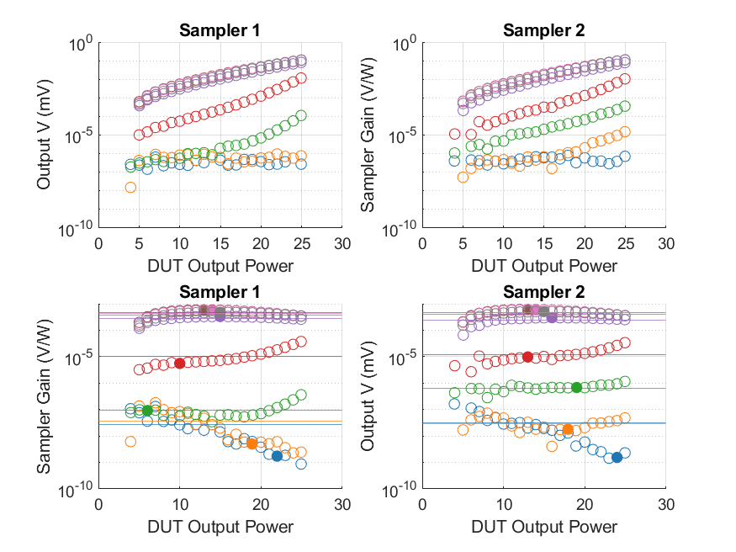
Coupled Line Performance At 9.20 GHz

Slide 16
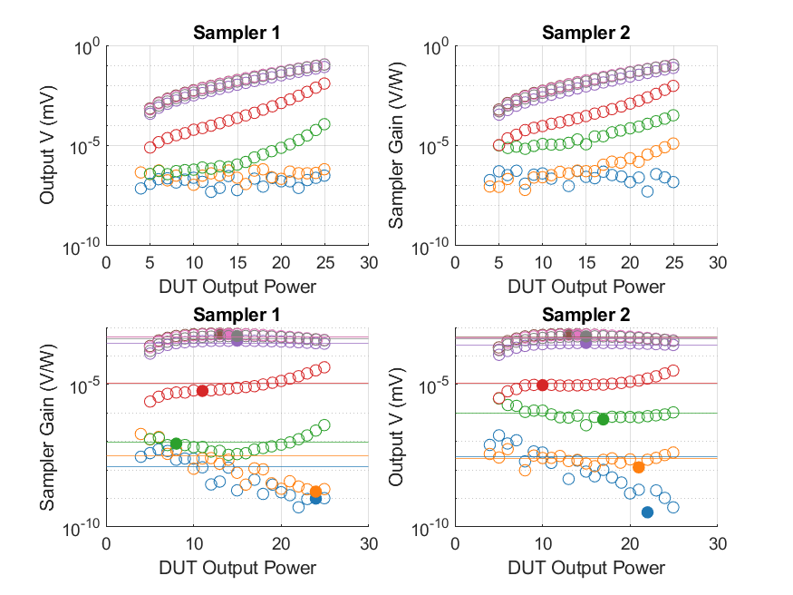
Coupled Line Performance At 9.30 GHz

Slide 17
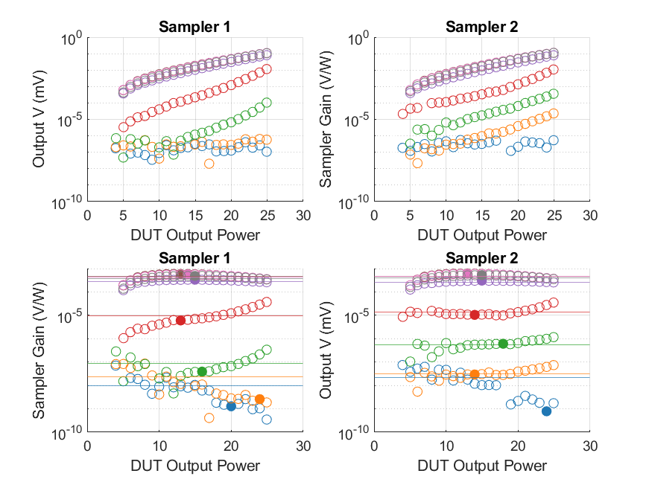
Coupled Line Performance At 9.40 GHz

Slide 18
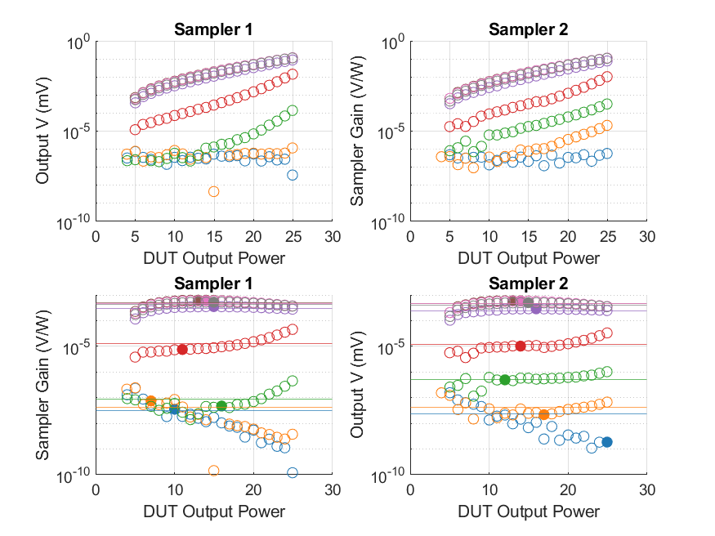
Coupled Line Performance At 9.50 GHz

Slide 19
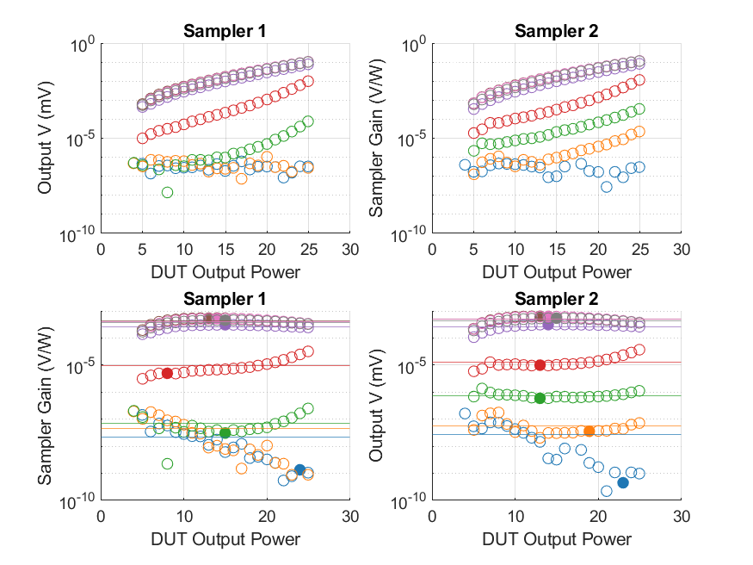
Coupled Line Performance At 9.60 GHz

Slide 20
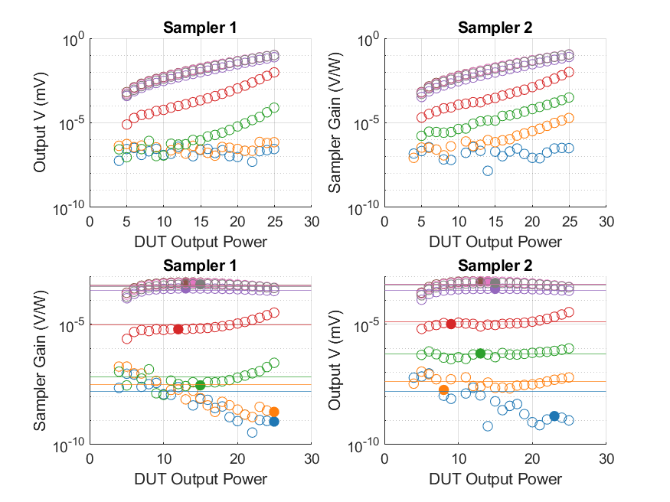
Coupled Line Performance At 9.70 GHz

Slide 21
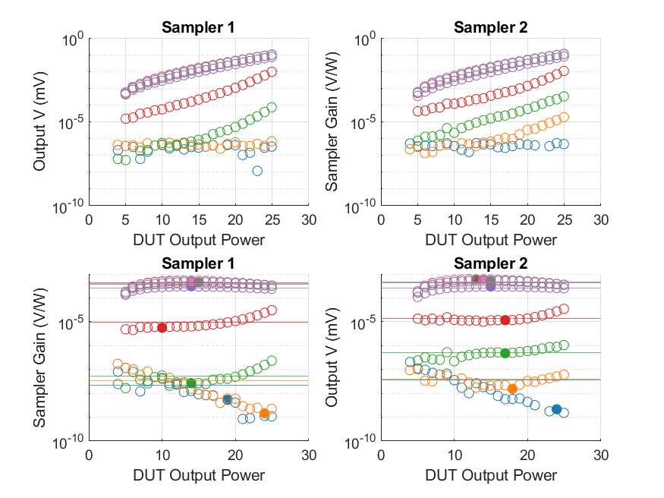
Coupled Line Performance At 9.80 GHz

Slide 22
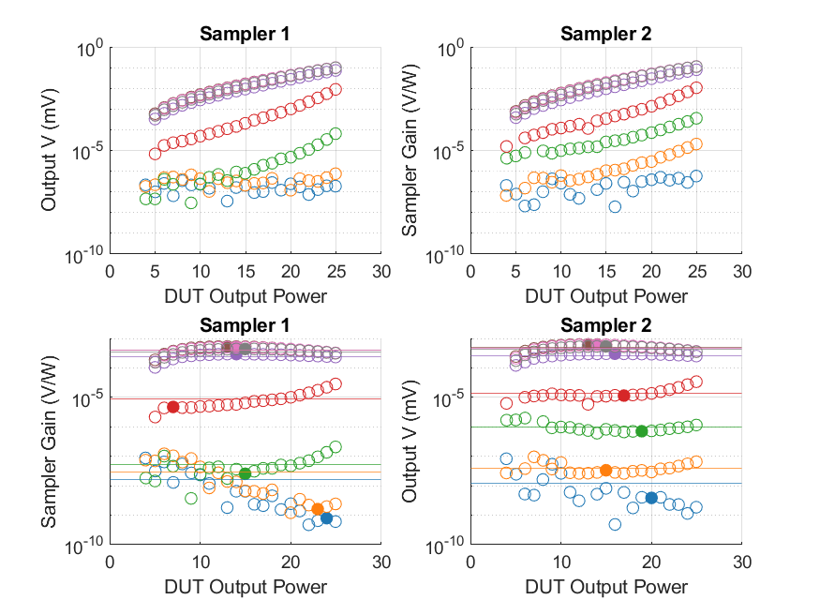
Coupled Line Performance At 9.90 GHz

Slide 23
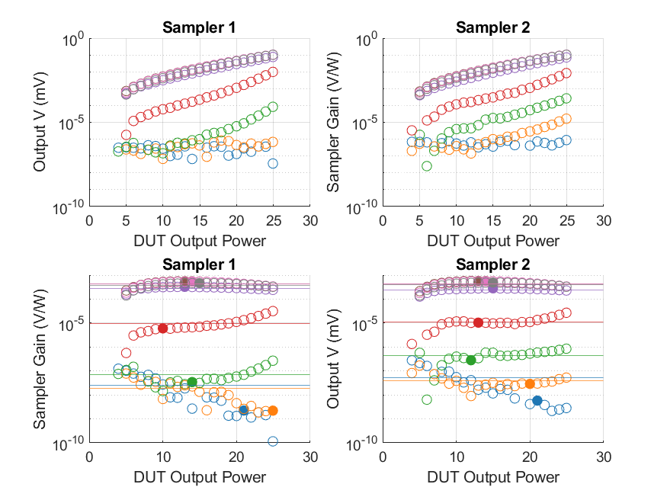
Coupled Line Performance At 10.00 GHz

Slide 24
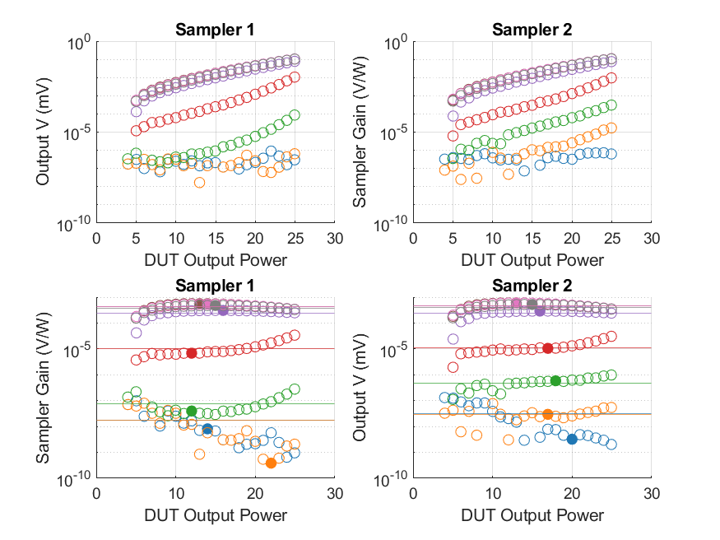
Coupled Line Performance At 10.10 GHz

Slide 25
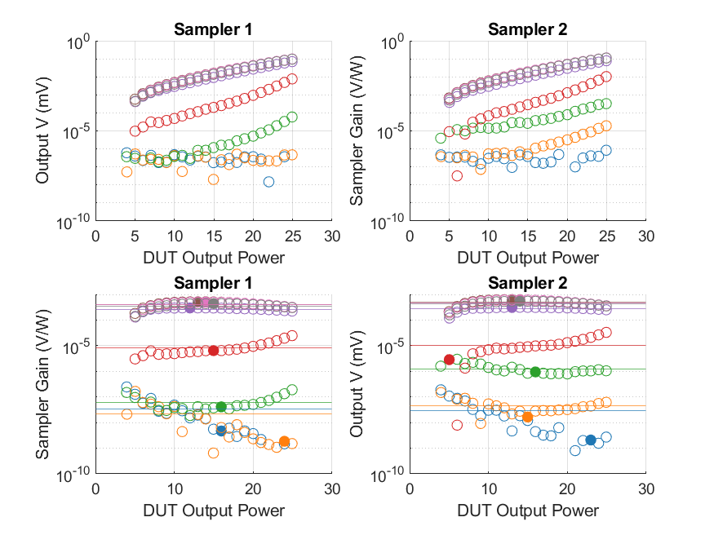
Coupled Line Performance At 10.20 GHz

Slide 26
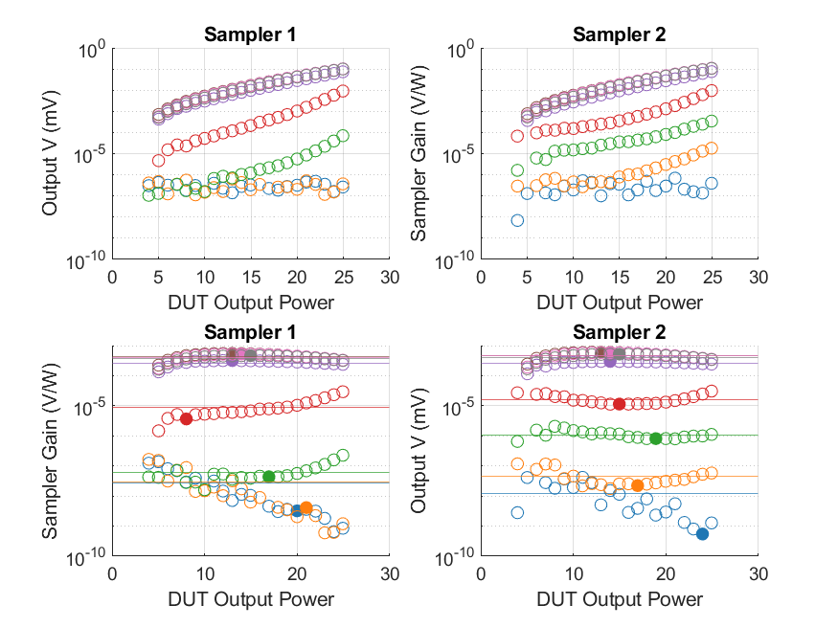
Coupled Line Performance At 10.30 GHz

Slide 27
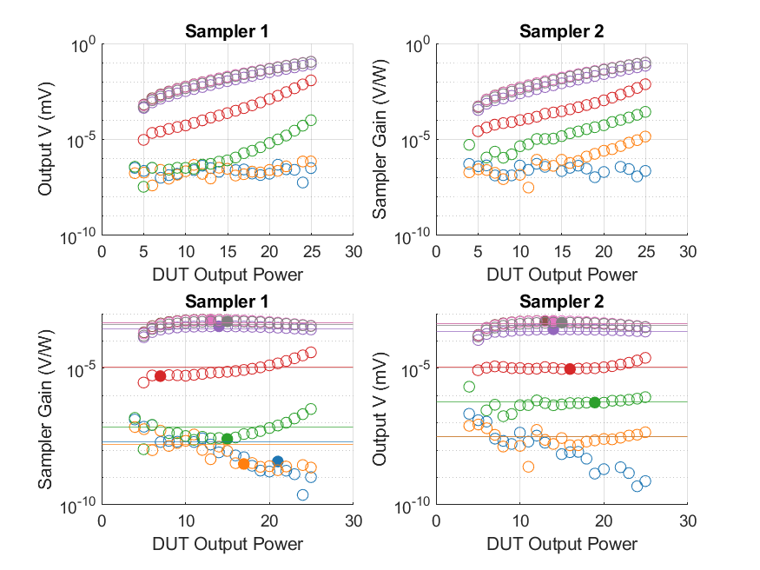
Coupled Line Performance At 10.40 GHz

Slide 28
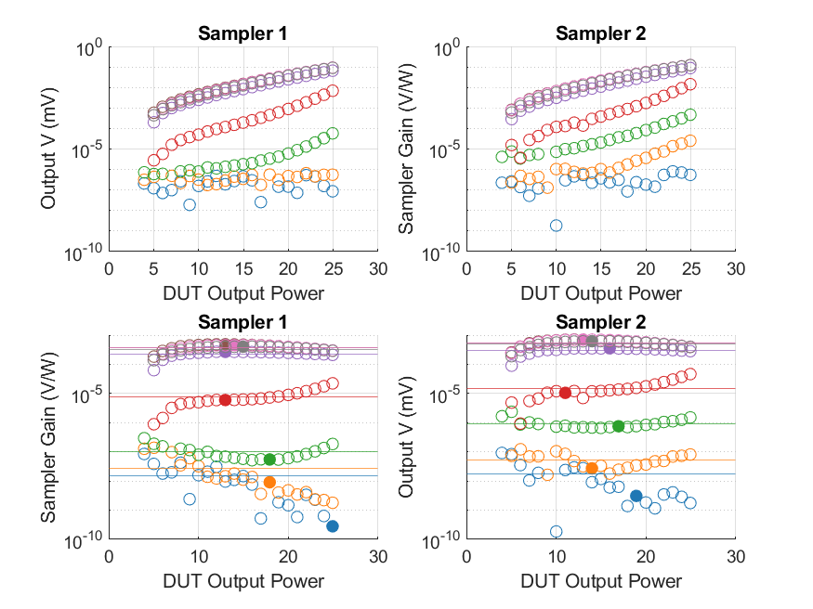
Coupled Line Performance At 10.50 GHz

Slide 29
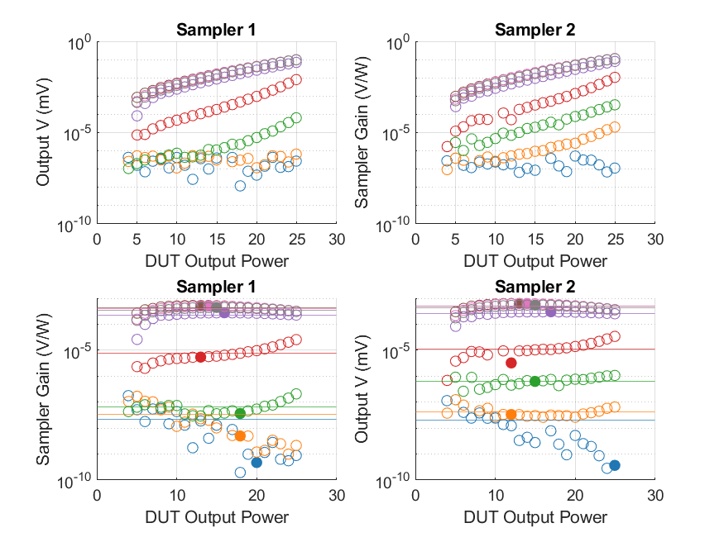
Coupled Line Performance At 10.60 GHz

Slide 30
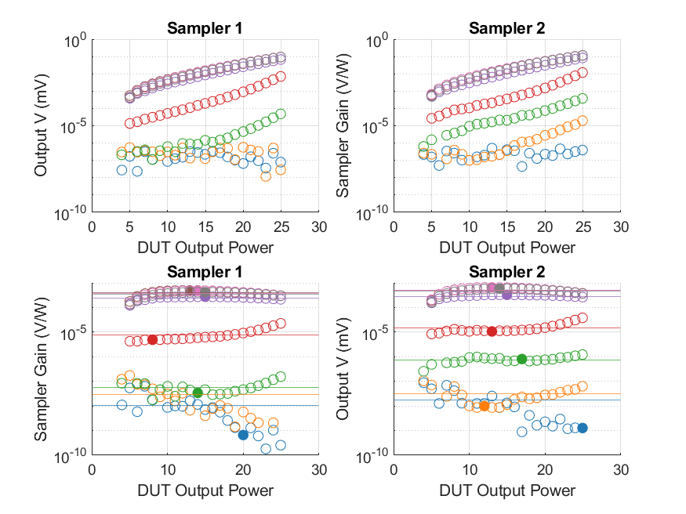
Coupled Line Performance At 10.70 GHz

Slide 31
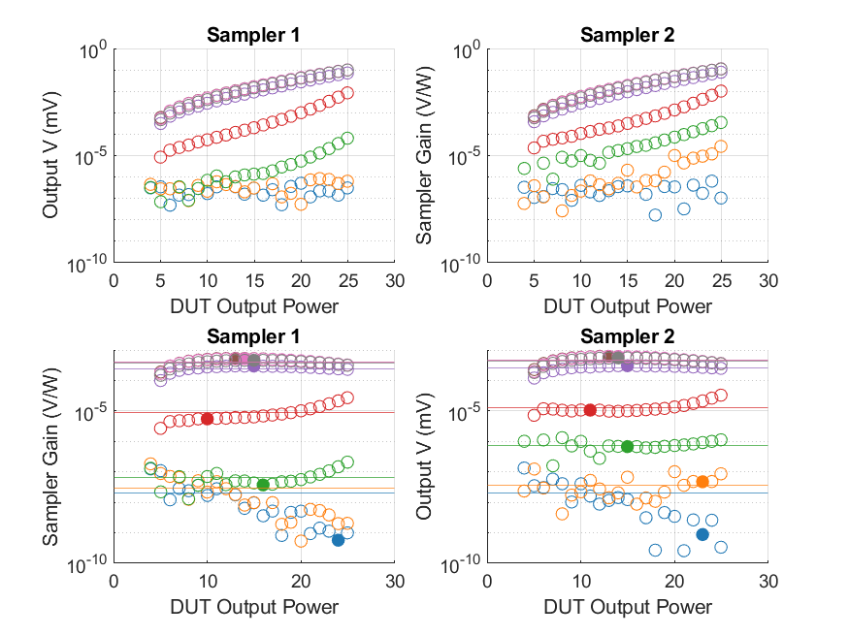
Coupled Line Performance At 10.80 GHz

Slide 32
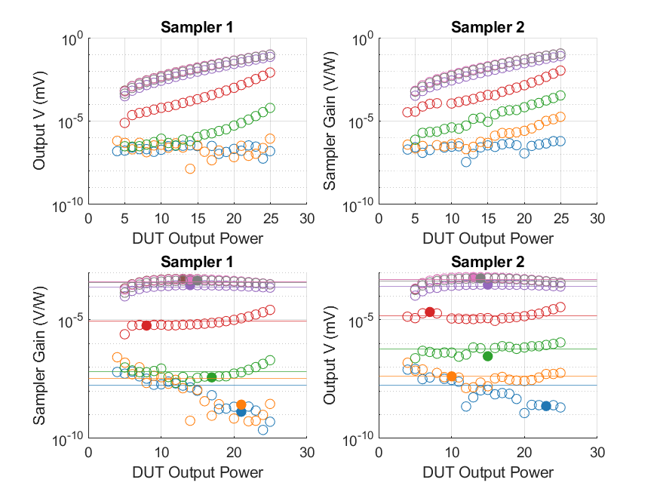
Coupled Line Performance At 10.90 GHz

Slide 33
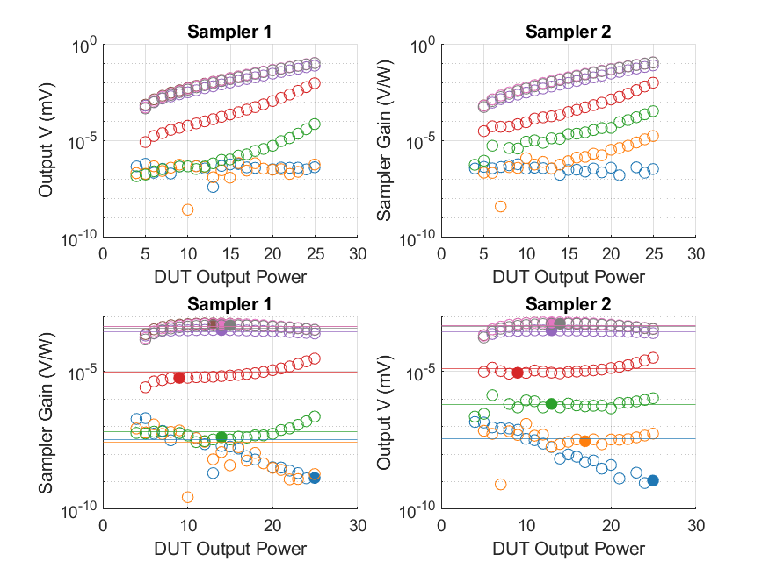
Coupled Line Performance At 11.00 GHz

Slide 34
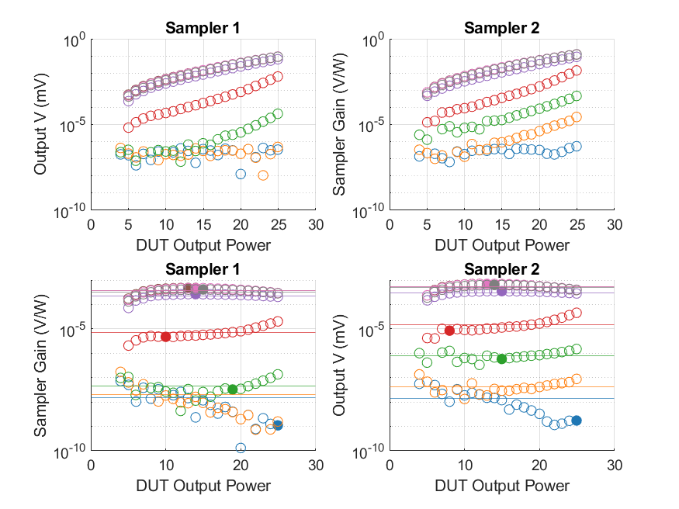
Coupled Line Performance At 11.10 GHz

Slide 35
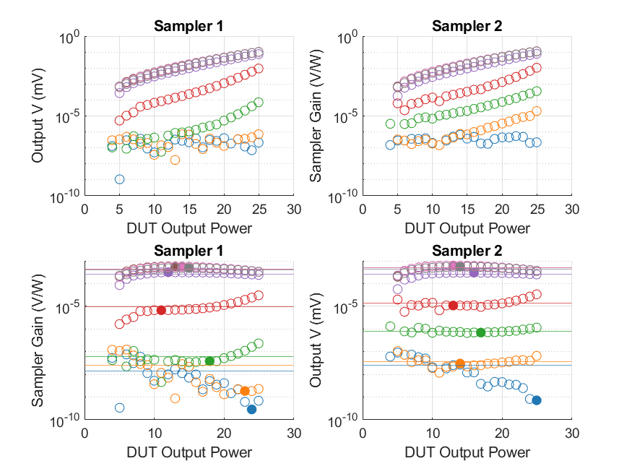
Coupled Line Performance At 11.20 GHz

Slide 36
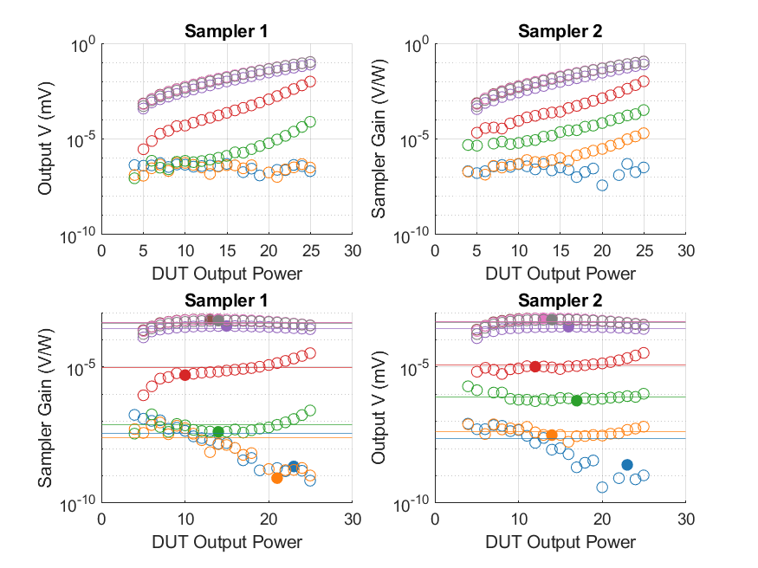
Coupled Line Performance At 11.30 GHz

Slide 37
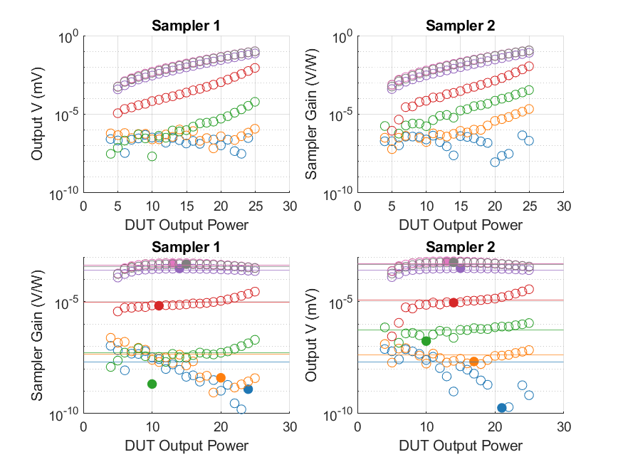
Coupled Line Performance At 11.40 GHz

Slide 38
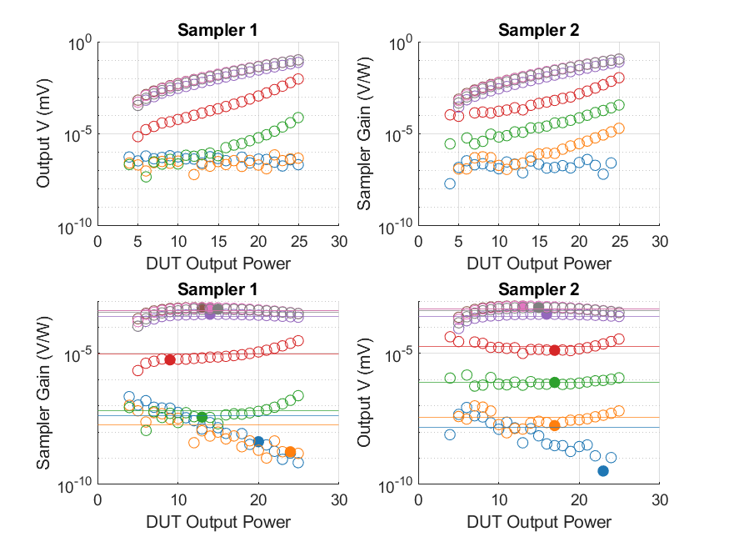
Coupled Line Performance At 11.50 GHz

Slide 39
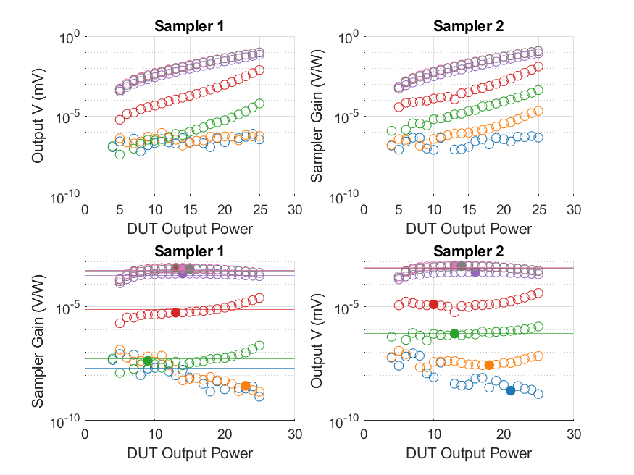
Coupled Line Performance At 11.60 GHz

Slide 40
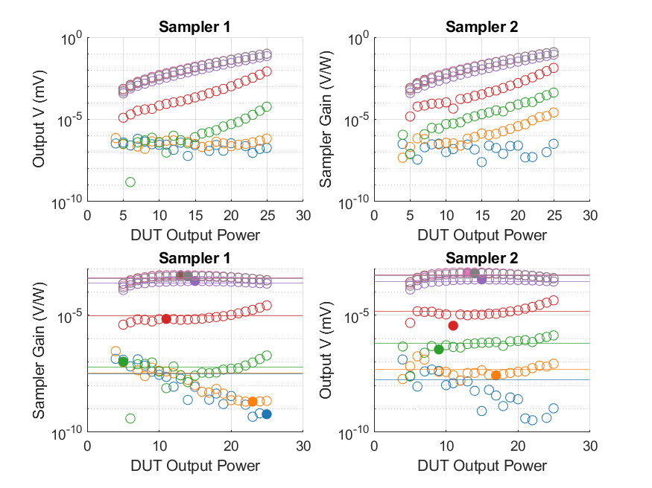
Coupled Line Performance At 11.70 GHz

Slide 41
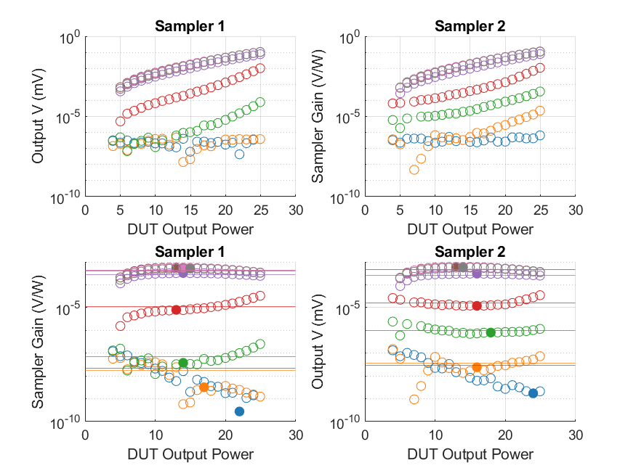
Coupled Line Performance At 11.80 GHz

Slide 42
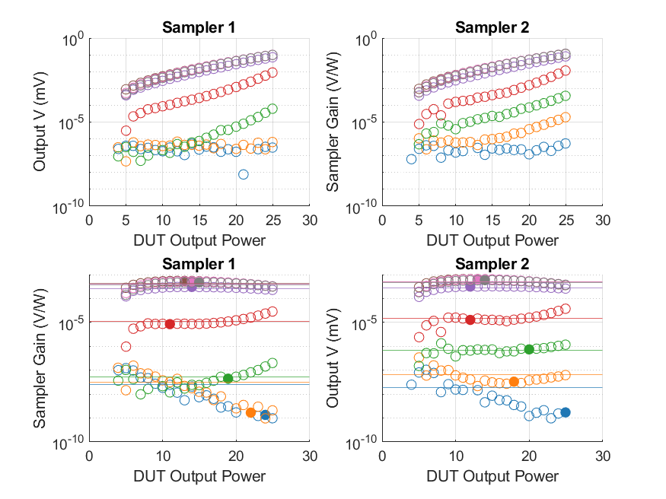
Coupled Line Performance At 11.90 GHz

Slide 43
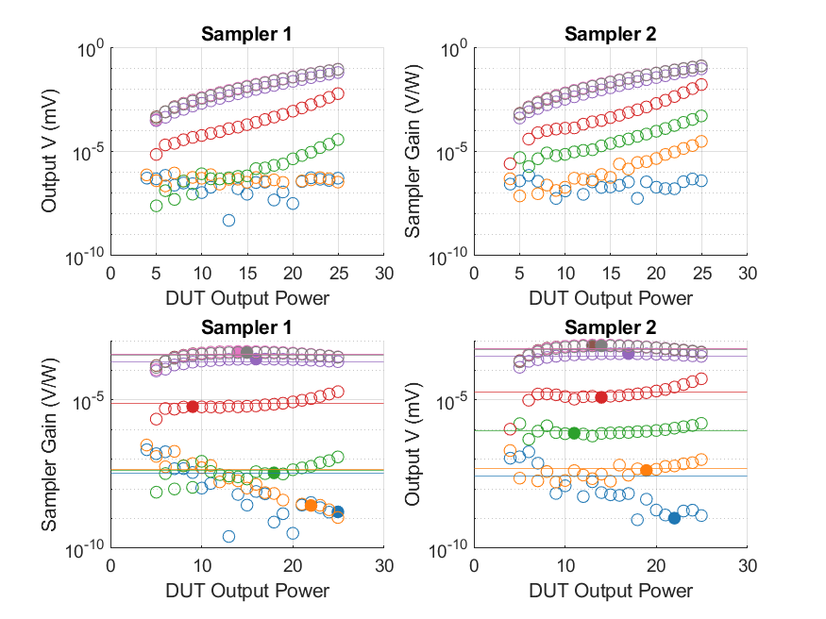
Coupled Line Performance At 12.00 GHz

Slide 44
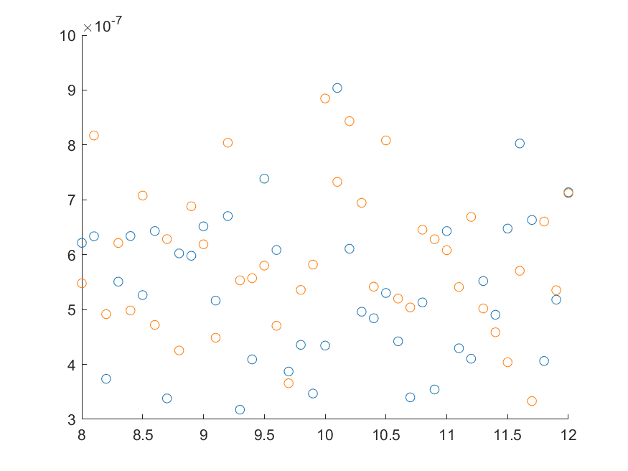
Coupled Line Performance At 0.25 Mean Sampler Bias

Slide 45
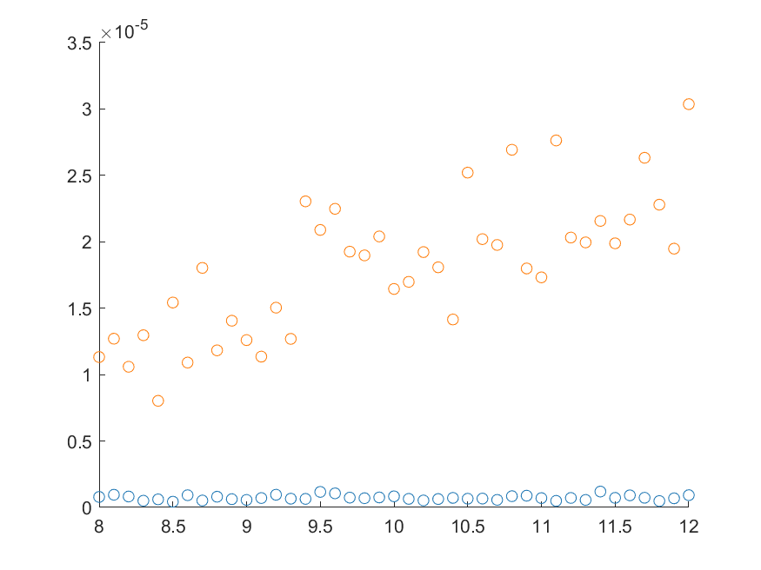
Coupled Line Performance At 0.50 Mean Sampler Bias

Slide 46
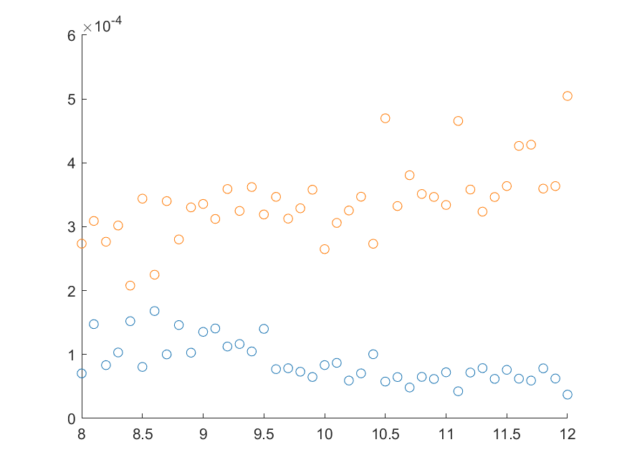
Coupled Line Performance At 0.75 Mean Sampler Bias

Slide 47
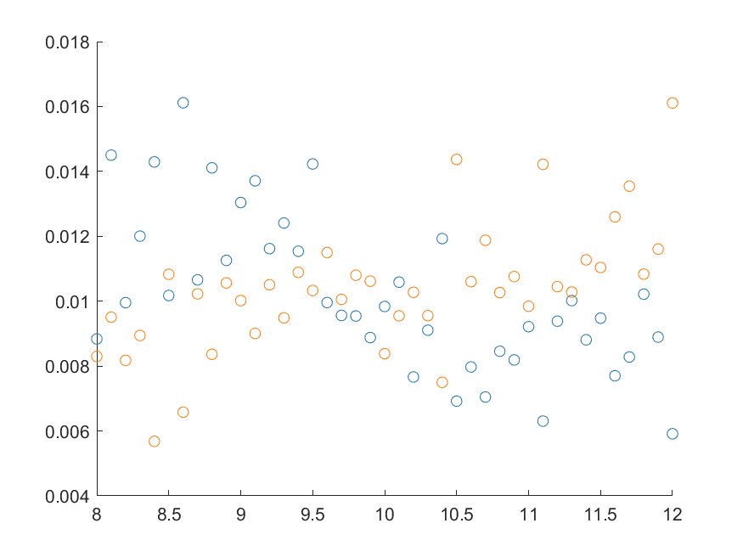
Coupled Line Performance At 1.00 Mean Sampler Bias

Slide 48
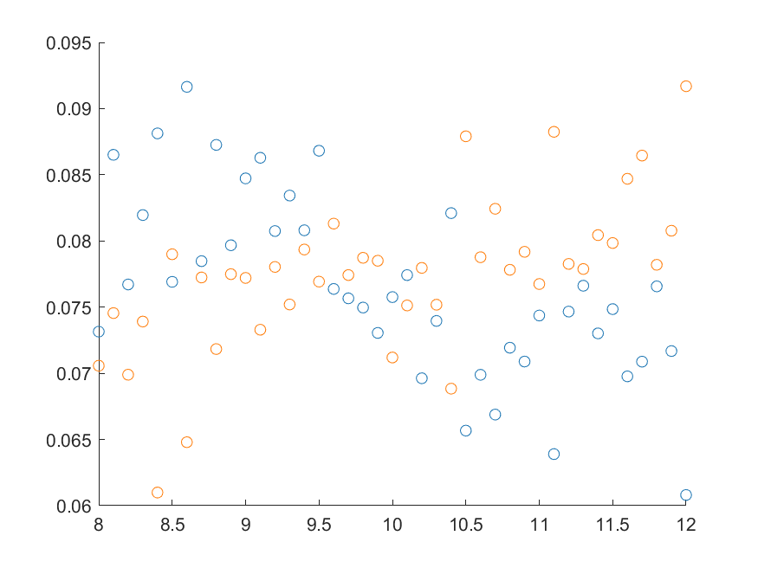
Coupled Line Performance At 1.25 Mean Sampler Bias

Slide 49
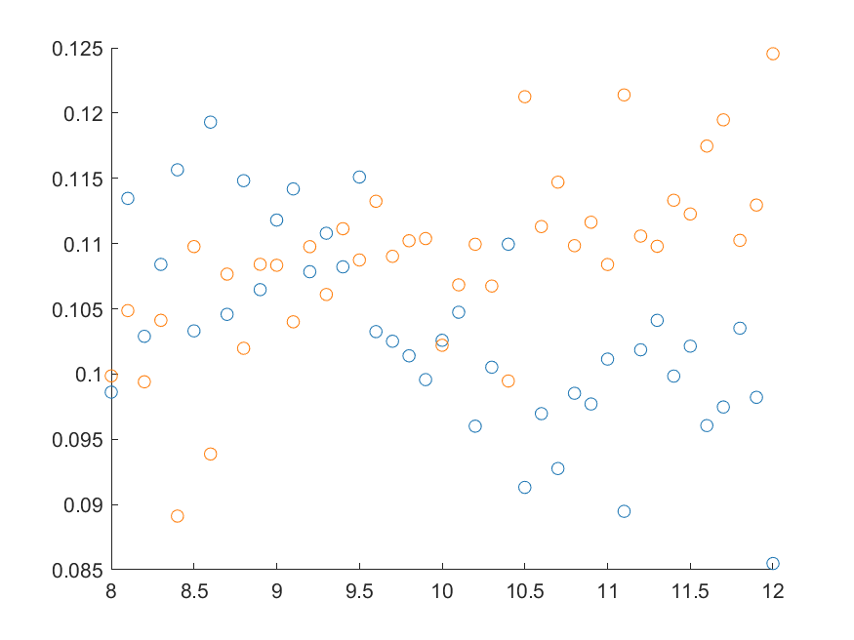
Coupled Line Performance At 1.50 Mean Sampler Bias

Slide 50
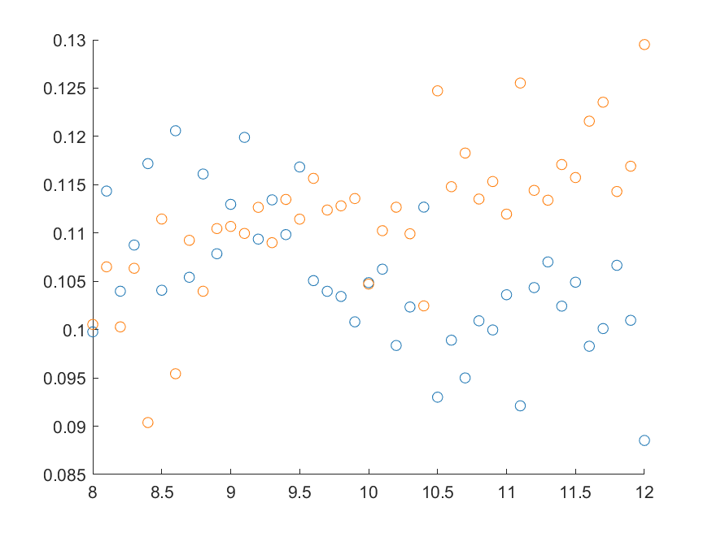
Coupled Line Performance At 1.75 Mean Sampler Bias

Slide 51
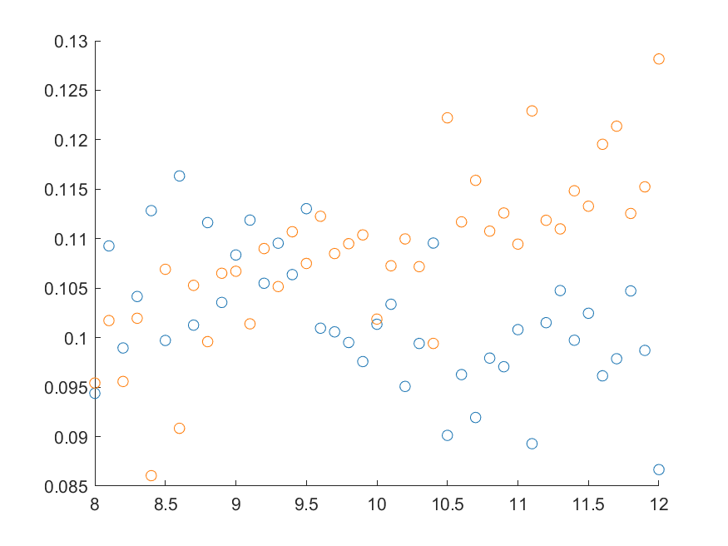
Coupled Line Performance At 2.00 Mean Sampler Bias

Slide 52

Coupled Line Mismatch

